Slide 1
Rundown of the Medical Natural Language Processing Task based on Actual Documents
Group Number: 02
22241158 Sabrina Tabassum
18301189 S. M. Navin Nayer Anik
18101296 Fahim Abrar
ST: Md Farhadul Islam
RA: Md Sabbir Hossain
‹#›

Slide 2
Introduction
NLP has seen significant advancements in the medical domain
Self-supervised pre-training of Transformer-style structures improved medical image and writing analysis
Optimal combination of deep learning for medical imaging and medical NLP reviewed
NLP used to predict medical specializations upon hospital admission
AI-based medical chatbot proposed to reduce healthcare costs and make medical information more approachable
NLP has the potential to revolutionize healthcare and improve patient outcomes.
‹#›

Slide 3
Develop a deep learning NLP model for Korean medical language
Methodology:
Compile Korean medical corpus
Pre-train with BERT medical field program
Develop NLP model with intricate representation of Korean language
Results:
Achieved accuracy scores of 0.147 and 0.148
Considerable rise in accuracy during intrinsic assessment
Increase in Pearson correlation for named entity recognition
Increase in extrinsic evaluation of semantic textual similarity data
Conclusions:
Results demonstrate progress in model development
Extrapolation from extrinsic data suggests improvements in named entity recognition and semantic textual similarity data
‹#›

Slide 4
Self-Supervised Pretraining for NLP and Vision-Language Problems
Methodology:
Use Masked Vision-Language Modeling (MVLM) on large medical picture and caption dataset
Obtain deeper semantic representations of medical pictures and words
Results:
Suggested method achieves superior results on two VQA datasets for radiology photographs (VQA-Med 2019 and VQA-RAD) compared to ensemble models of best answers achieved in the past
Provides attention maps that make model interpretation easier
Conclusions:
Improved performance on VQA datasets for radiology photographs
Easier model interpretation with attention maps
‹#›

Slide 5
Self-Supervised Pretraining for NLP, Vision, and Language Problems
Methodology:
Use self-supervised pre-training of Transformer-style structures
Apply modeling as the pretext job on a big dataset of medical photographs and language
Results:
Suggested method outperforms ensemble models of previous best solutions on twin VQA datasets for radiology photos
Provides attention maps that make model interpretation easier
Conclusions:
Improved performance on VQA datasets for radiology photos
Easier model interpretation with attention maps
‹#›

Slide 6
Deep Learning for Medical Imaging and Medical NLP
Objective:
Offer a comprehensive literature review of deep learning for medical imaging and medical NLP
Topics covered: tasks, pipelines, and impediments
Architecture of deep learning in medical NLP and medical imaging
Improve diagnosis accuracy by determining the ideal combination of deep learning, natural language processing, and medical imaging
Findings:
Optimal combination of deep learning, NLP, and medical imaging
Challenges in using deep learning for medical NLP and medical imaging
Conclusions:
Offers a comprehensive literature review of deep learning for medical imaging and medical NLP
Provides insights into challenges and opportunities in these fields
‹#›

Slide 7
Medical Knowledge Incorporation into Pre-trained BERT Model for Clinical Connection Extraction
Introduction:
Focuses on incorporating medical knowledge into pre-trained BERT model for clinical connection extraction
Compares several methods and presents benchmark results
Dataset used: i2b2/VA 2010 clinical connection extraction dataset
Methods compared:
BERT baseline model
BERT with external medical resources
BERT with internal medical resources
BERT with both internal and external medical resources
Best model developed by authors beats cutting-edge methods
Outperforms BERT baseline model by a significant margin
Conclusions:
Incorporating medical knowledge improves the performance of pre-trained BERT model for clinical connection extraction
Combination of internal and external medical resources yields the best results
‹#›

Slide 8
A Novel Interactive Interface for Medical Research Papers
Methodology:
Definitions of unfamiliar terms
In-situ plain language section summaries
Key questions directing readers to relevant passages
Plain language summaries of answer-containing passages
Results:
Improved comprehension of research papers
No reduction in paper comprehension compared to conventional PDF viewer
Facilitates reading of medical papers
Gives readers more confidence when approaching research papers
Conclusions:
The findings of the study indicate that Paper Plain1 is a promising tool for researchers and readers of medical papers.
‹#›

Slide 9
Medical Concept Annotation Analysis Tool: MedCAT
Methodology:
Innovative self-supervised machine learning algorithm for concept extraction
Feature-rich annotation interface for customizing and refining IE models
Interfaces to the wider CogStack ecosystem for vendor-neutral health system implementation
Results:
UMLS ideas obtained from open datasets
SNOMED-CT extraction demonstrated at three of London's prestigious hospitals
F1 scores of 0.448-0.738 vs 0.429-0.650
High degree of transferability (F1 > 0.94) across hospitals, datasets, and concept categories
Conclusions:
MedCAT is a powerful tool for concept extraction and annotation in medical research, with a high degree of customization and transferability across domains.
‹#›

Slide 10
Problem Statement
The problem:
Medical data is complex and requires specialized knowledge and language, making it challenging for traditional NLP models to accurately process and analyze.
This leads to inaccuracies in tasks such as medical entity recognition, semantic textual similarity, and medical question answering.
Proposed Solution:
Develop and improve deep learning-based NLP models specifically for medical data.
The goal is to improve accuracy in medical NLP tasks.
The studies also explore the potential applications of NLP in the medical field, such as medical information extraction, disease diagnosis, and predicting medical specializations.
Importance:
Accurate NLP models for medical data can improve patient outcomes by facilitating more accurate diagnoses and treatment plans.
NLP can also improve healthcare efficiency by automating tasks such as medical record analysis and report generation.
‹#›

Slide 11
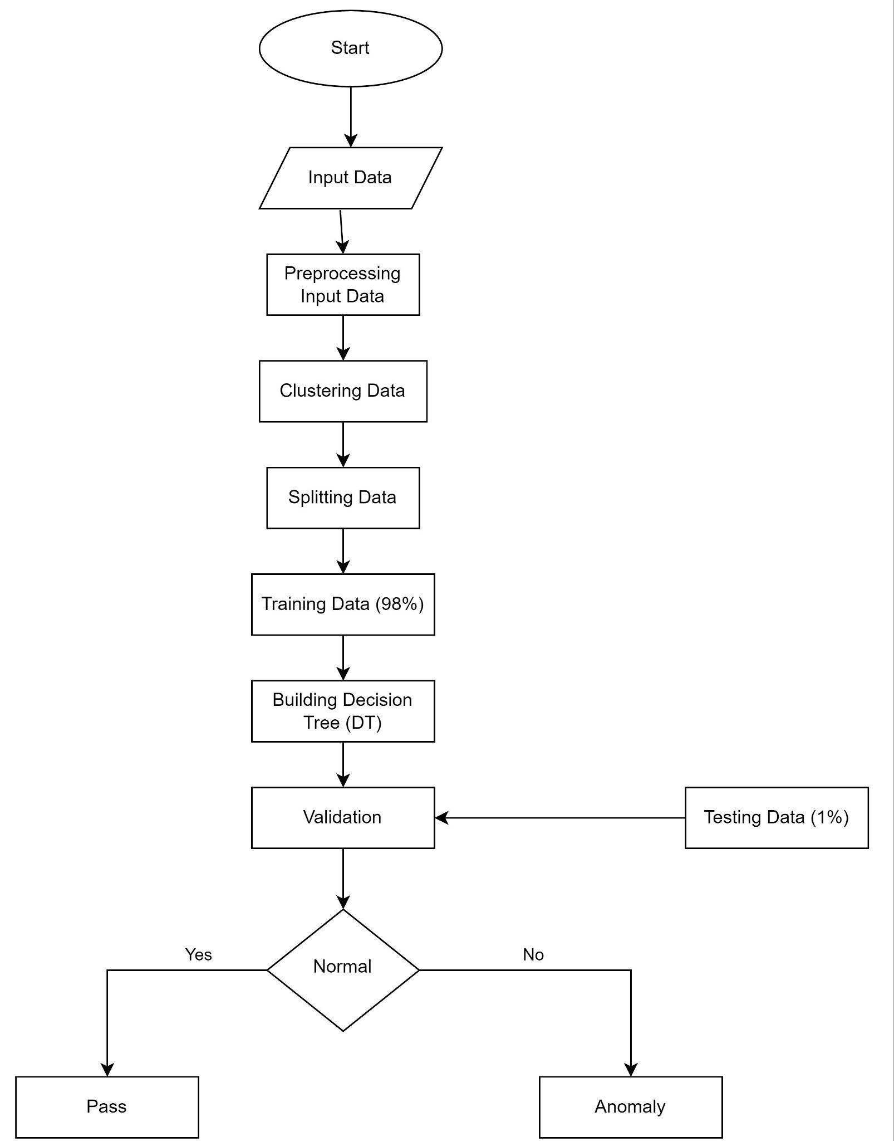
Proposed Work Plan
‹#›

Slide 12
Conclusion
Advancements in NLP in the medical domain have potential to revolutionize healthcare and improve patient outcomes.
Deep learning-based NLP models specifically for medical data have demonstrated progress in accuracy and performance.
NLP can improve healthcare efficiency by automating tasks such as medical record analysis and report generation.
‹#›

